Slide 1
Automation Excersices website testing

Slide 2

CONTENT
1
Brief about
website
4
Automation
Testing
2
Detailed Test
Cases
5
Defect Reports
and Issues
3
6
Api Testing
Link For GitHub

Slide 3
Automation Excersices website
Simple Brief about the website that it is a Branding clothes men, women and kids wear.
We detail making manual test cases, API testing, defect report and Automation testing for the website.

Slide 4
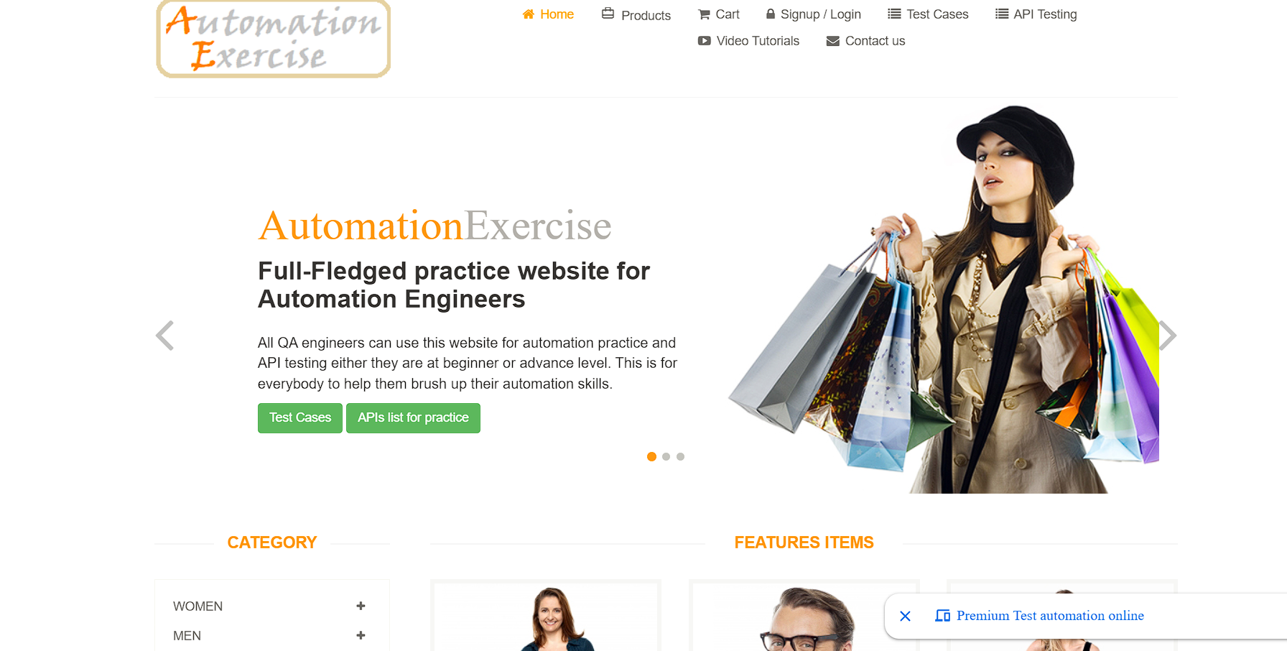

Slide 5
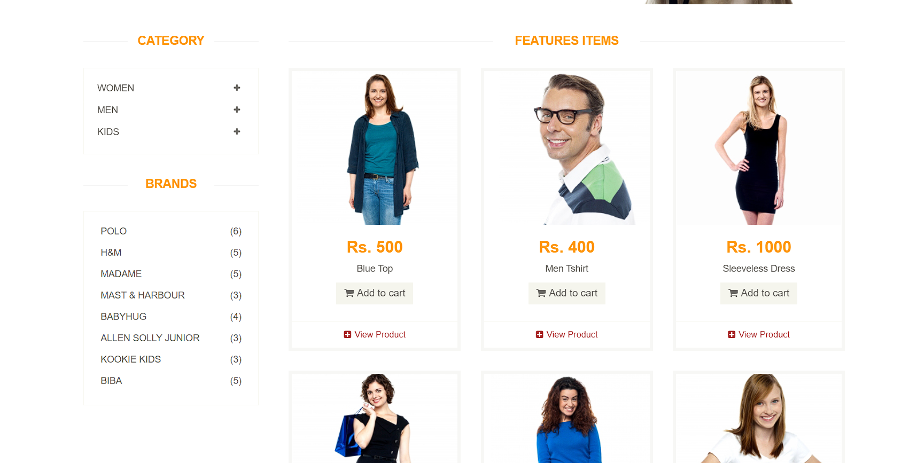

Slide 6
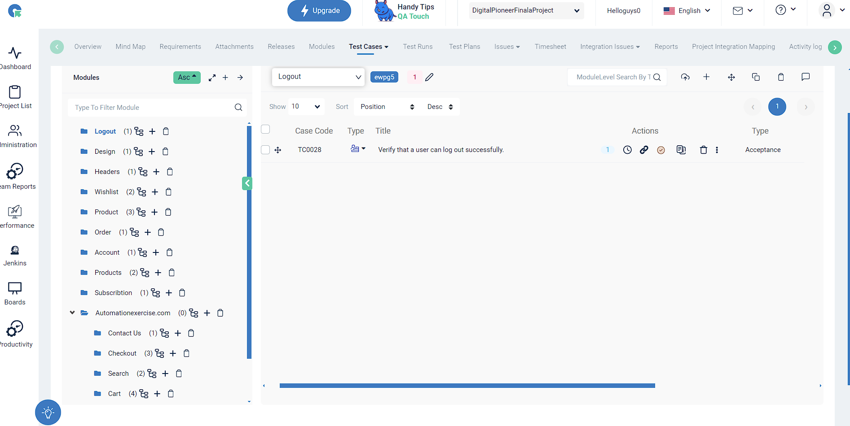

Awesome Company
“There is nothing noble in being superior to some other man. The true nobility is in being superior to your previous self.”
But all sunshine without shade, all pleasure without pain, is not life at all. Take the lot of the happiest - it is a tangled
“There is nothing noble in being superior to some other man. The true nobility is in being superior to your previous self.”

Slide 7
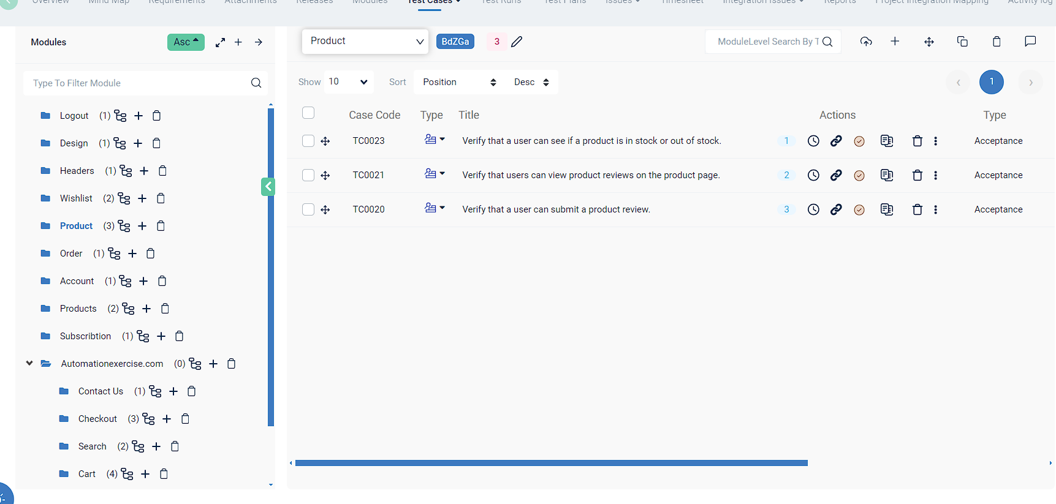

INTRODUCTION
You are able to add subtitles here.
Who we are?
What we do?
What we CARE?
Youth is not a time of life; it is a state of mind; it is not a matter of rosy cheeks, red lips and supple knees; it is a matter of the will, a quality of the imagination, a vigor of the emotions; it is the freshness of the deep springs of life.
Youth is not a time of life; it is a state of mind; it is not a matter of rosy cheeks, red lips and supple knees; it is a matter of the will, a quality of the imagination, a vigor of the emotions; it is the freshness of the deep springs of life.
Youth is not a time of life; it is a state of mind; it is not a matter of rosy cheeks, red lips and supple knees; it is a matter of the will, a quality of the imagination, a vigor of the emotions; it is the freshness of the deep springs of life.
01

Slide 8
API Testing
It Ensures that the API performs its intended tasks correctly. This involves testing individual API endpoints (e.g., GET, POST, PUT, DELETE requests) to verify they return the expected results based on input parameters.
To Perform API Testing We use Postman Tool for manually sending HTTP requests and analyzing responses.

Slide 9
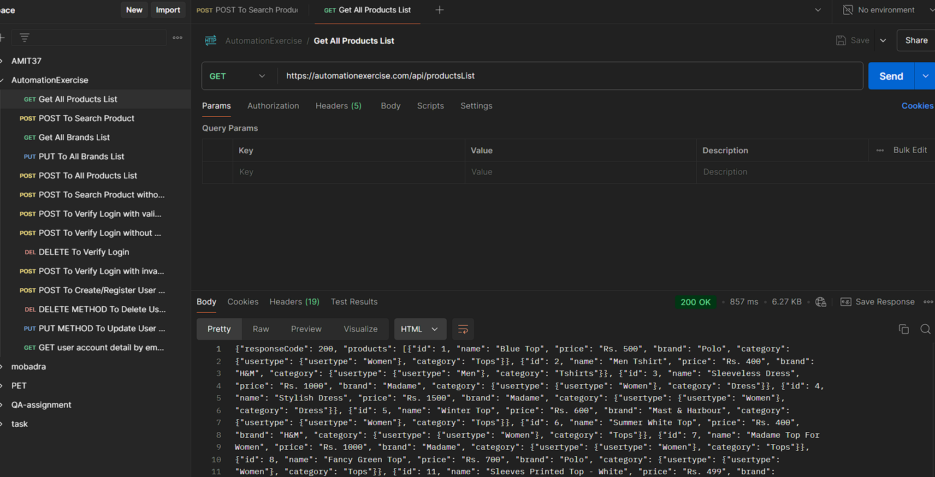

Slide 10
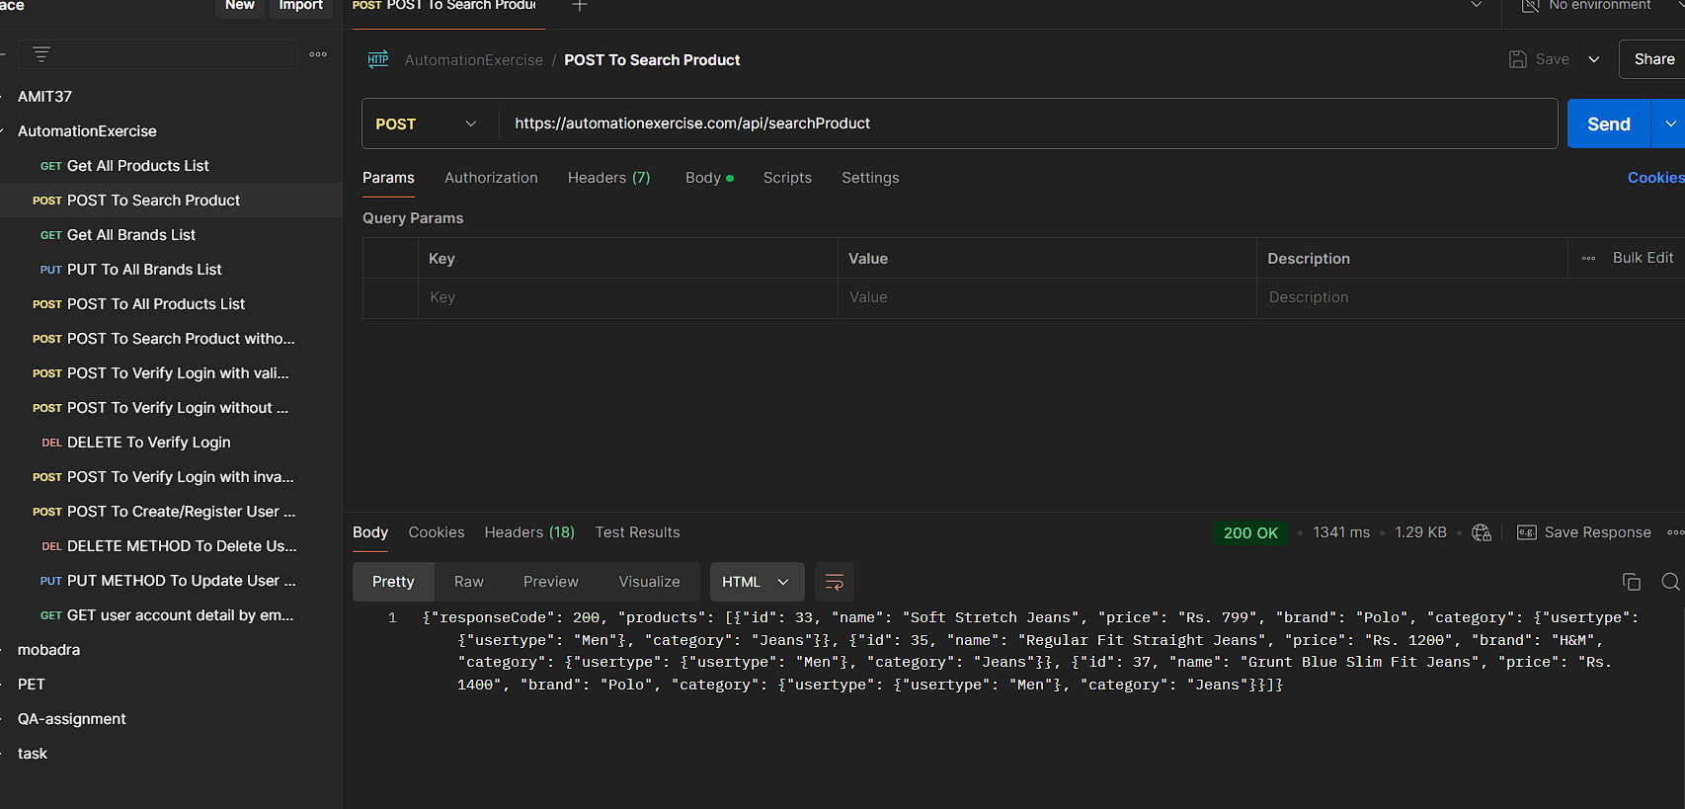

Slide 11
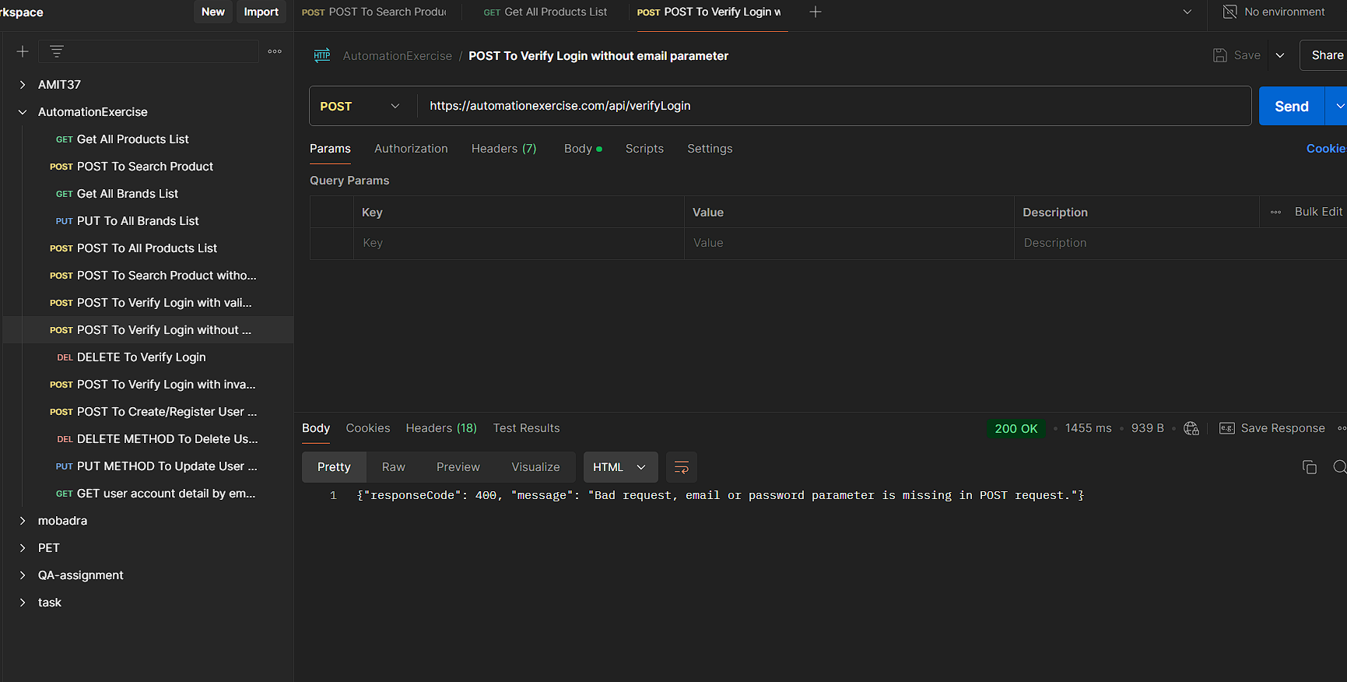

Slide 12
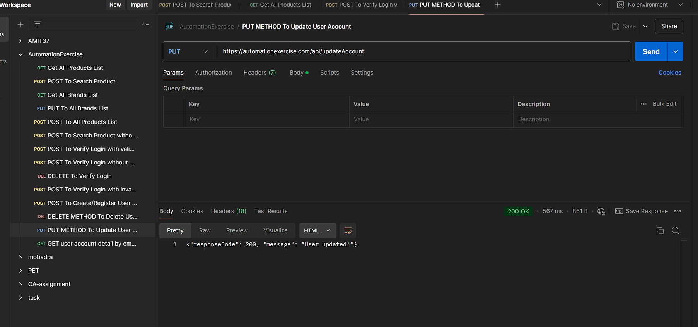

Slide 13
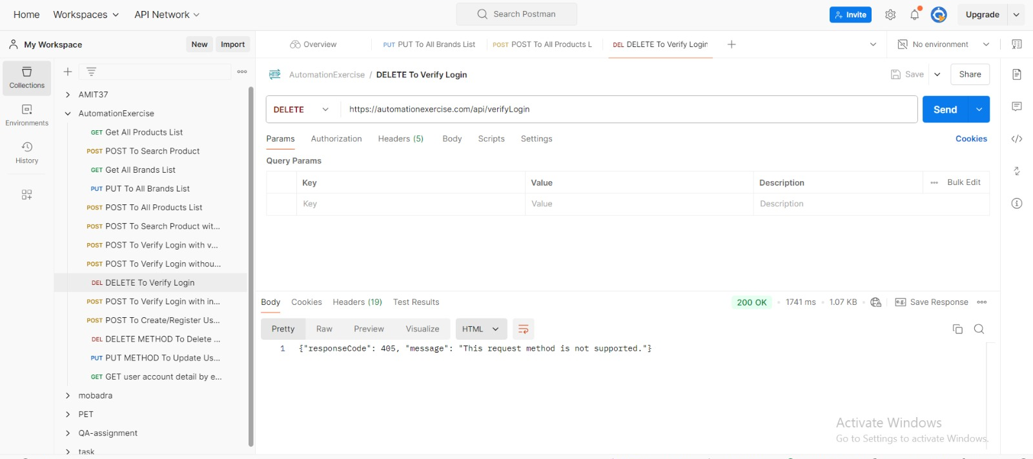

Slide 14


Slide 15


Slide 16
Automation Testing
We use Seilinum JAVA with InteliiJ to run the automation testing.
The Next Slide will show the Code for Automation
testing to the website ..

Slide 17
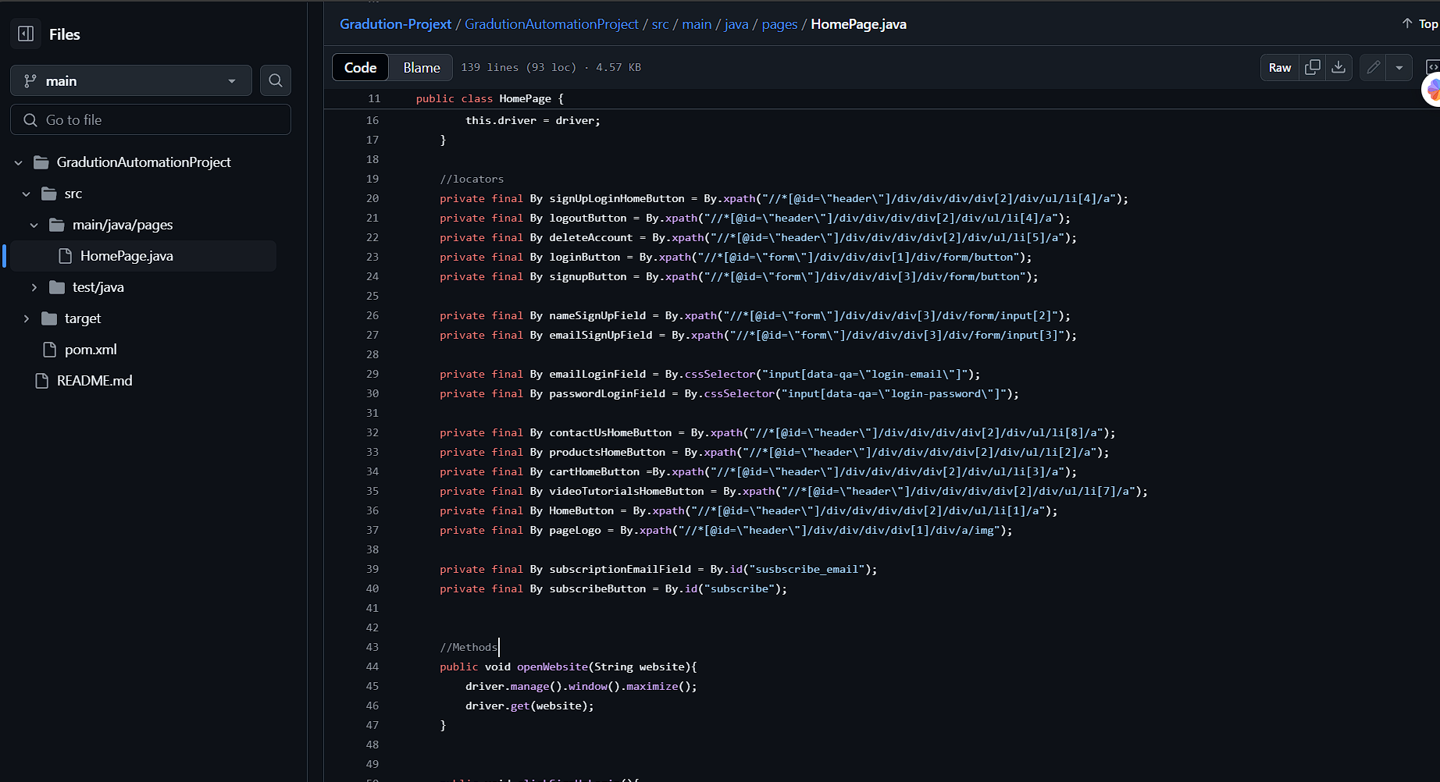

Slide 18
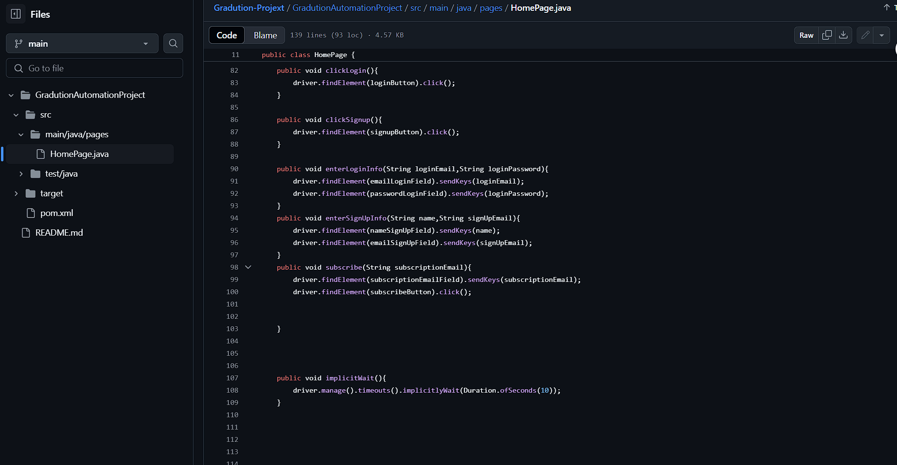

Slide 19
Link of the Project on GitHub
https://github.com/Mefre7/Gradution-Projext

Slide 20
Defect report
A defect report is a formal document used in software testing to report, track, and resolve defects (also called bugs or issues) found during the testing process.
It provides a detailed description of the problem, including its severity, how to reproduce it, and the impact it has on the system.
The Next Slides will show the Defects for Automation Exercise Website ..

Slide 21
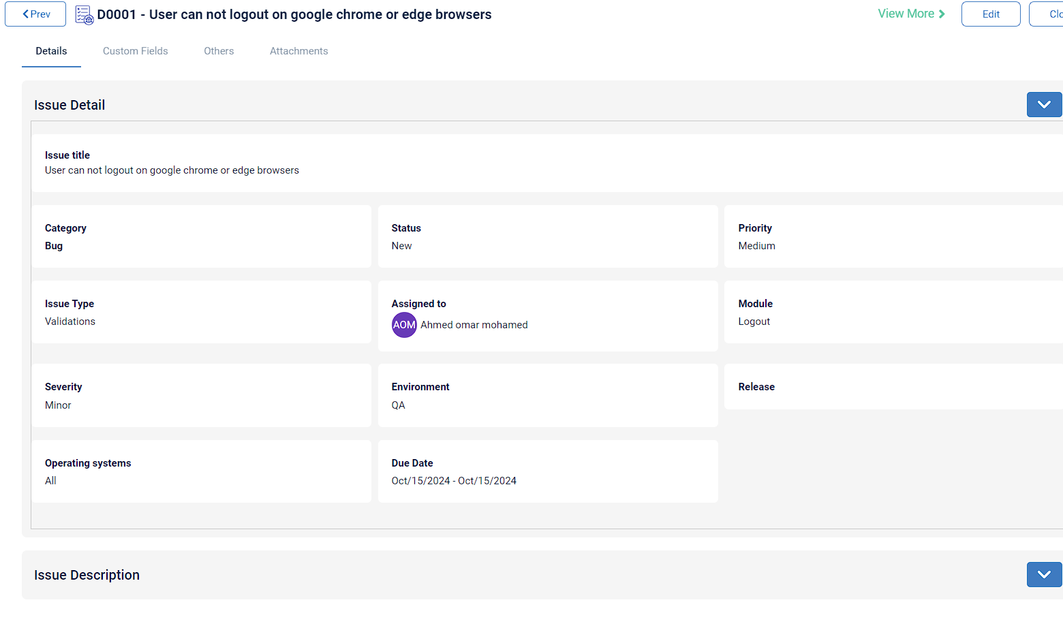

Slide 22
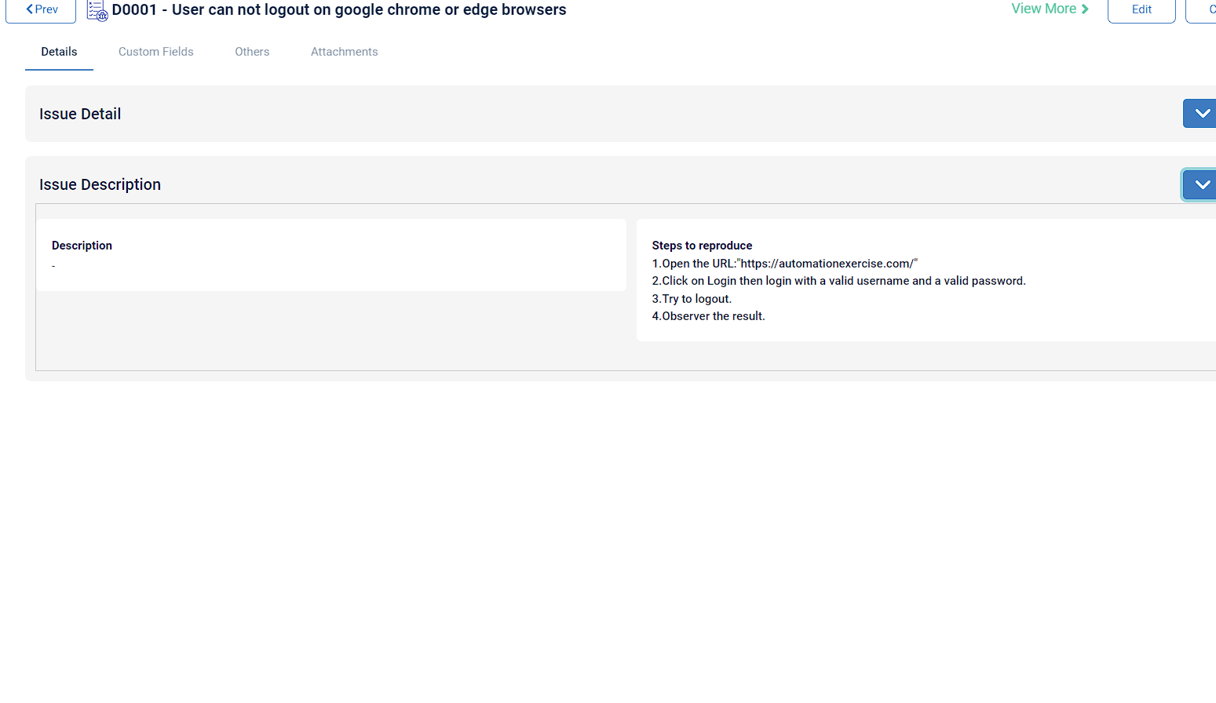

Slide 23
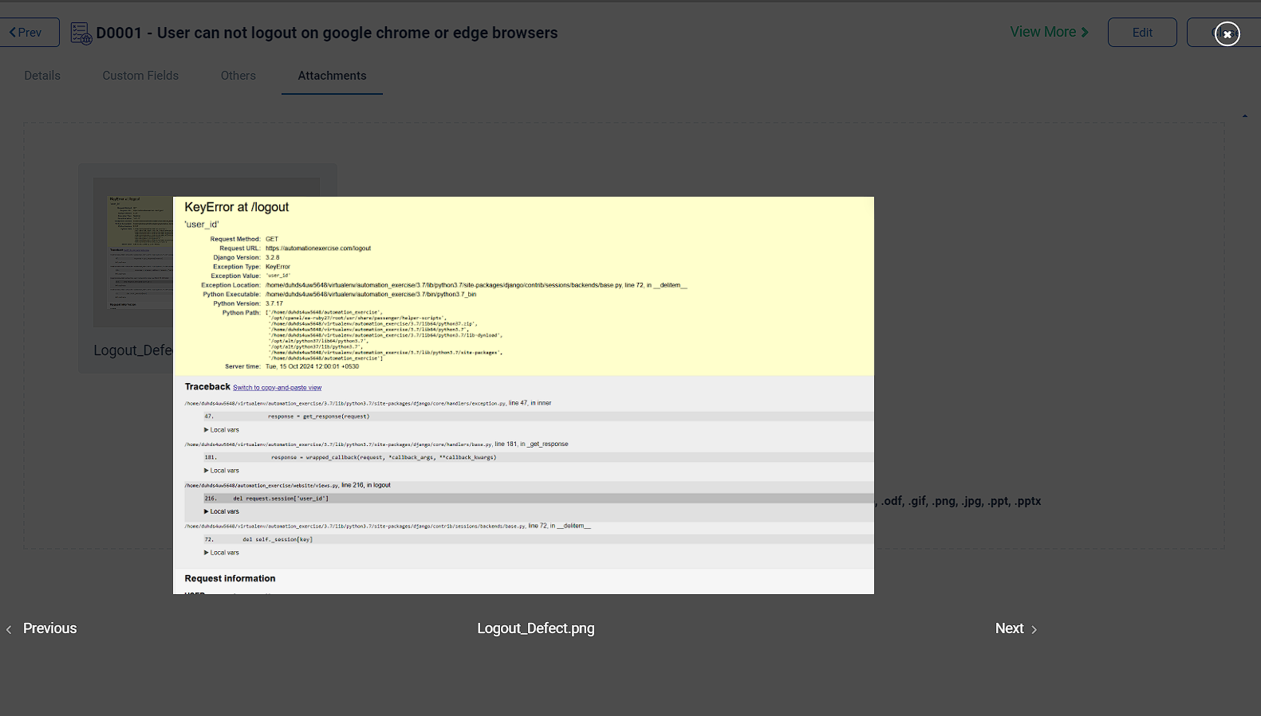

Slide 24
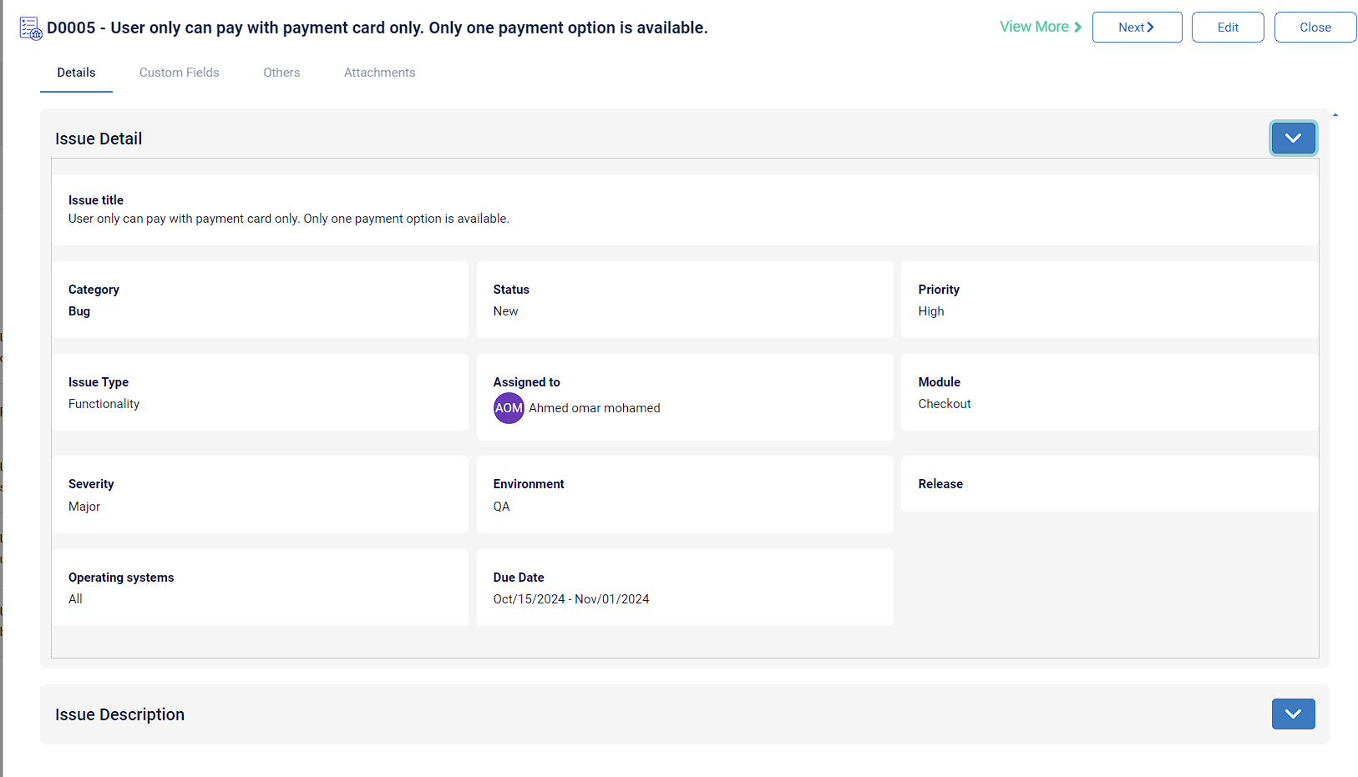

KEY TO SUCCESS
You are able to add subtitles here.
DESIGN
Youth is not a time of life; it is a state of mind; it is not a matter of rosy cheeks, red lips and
CONCEPTION
Youth is not a time of life; it is a state of mind; it is not a matter of rosy cheeks, red lips and
MARKETING
Youth is not a time of life; it is a state of mind; it is not a matter of rosy cheeks, red lips and
DESIGN
76%
CODING
70%
CONCEPTION
50%
SOCIAL MARKETING
MARKETING
80%
Youth is not a time of life; it is a state of mind; it is not a matter of rosy cheeks, red lips and
SOCIAL MARKETING
88%
01

Slide 25
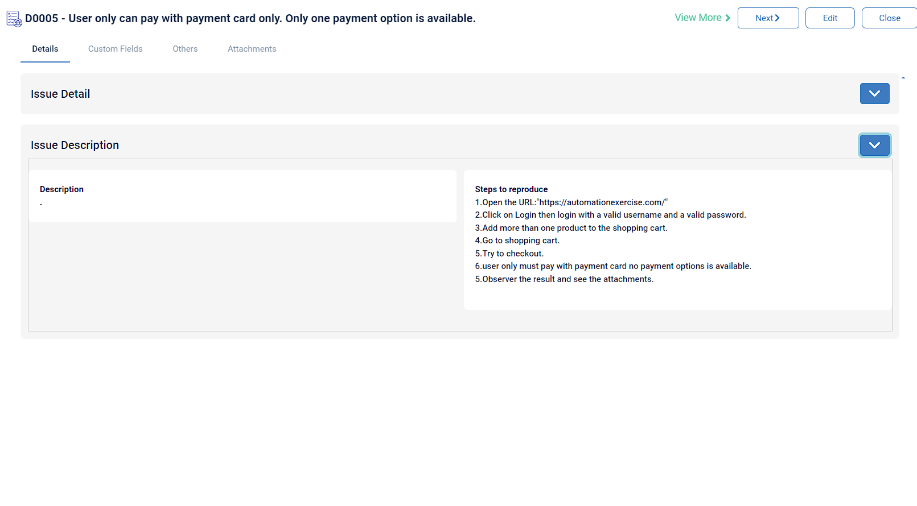


OUR IDEAS
You are able to add subtitles here.
BRAND STRATEGY
1
Youth is not a time of life; it is a state of mind; it is not a matter of rosy cheeks, red lips and supple knees;
Brand workshops
Brand architecture
Employer branding
Brand analysis
BRAND STRATEGY
2
Youth is not a time of life; it is a state of mind; it is not a matter of rosy cheeks, red lips and supple knees;
Brand workshops
Brand architecture
Employer branding
Brand analysis

Slide 26
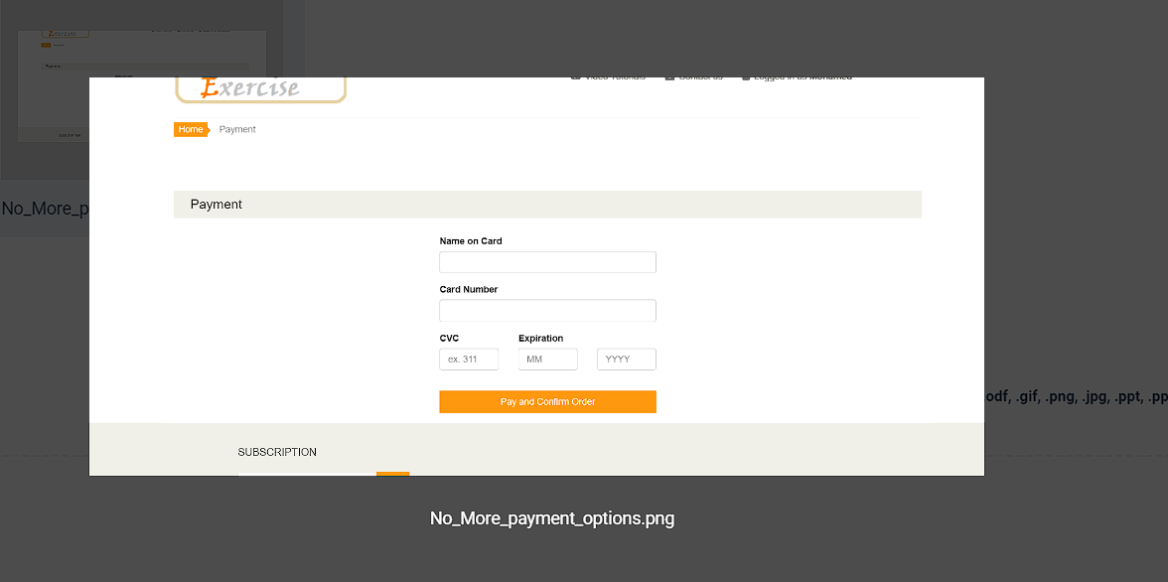

3
BRAND STRATEGY
Youth is not a time of life; it is a state of mind; it is not a matter of rosy cheeks, red lips and supple knees;
Brand workshops
Brand architecture
Employer branding
Brand analysis
BRAND STRATEGY
Youth is not a time of life; it is a state of mind; it is not a matter of rosy cheeks, red lips and supple knees;
4
Brand workshops
Brand architecture
Employer branding
Brand analysis
01

Slide 27
Any questions
Thank You
:-)

